Slide 1

SERVERLESS
.NET Applications on AWS. Containers

Slide 2

AGENDA —
Serverless | . . . . . . . . . . . . . . . . . . . . . . . . . . . . . . . . . . . . . . | 02
AWS Fargate | . . . . . . . . . . . . . . . . . . . . . . . . . . . . . . . . . . . . . . | 07
AWS SQS | . . . . . . . . . . . . . . . . . . . . . . . . . . . . . . . . . . . . . . | 29
AWS API Gateway | . . . . . . . . . . . . . . . . . . . . . . . . . . . . . . . . . . . . . . | 40
Application Overview | . . . . . . . . . . . . . . . . . . . . . . . . . . . . . . . . . . . . . . | 67
Practice | . . . . . . . . . . . . . . . . . . . . . . . . . . . . . . . . . . . . . . | 69

Slide 3
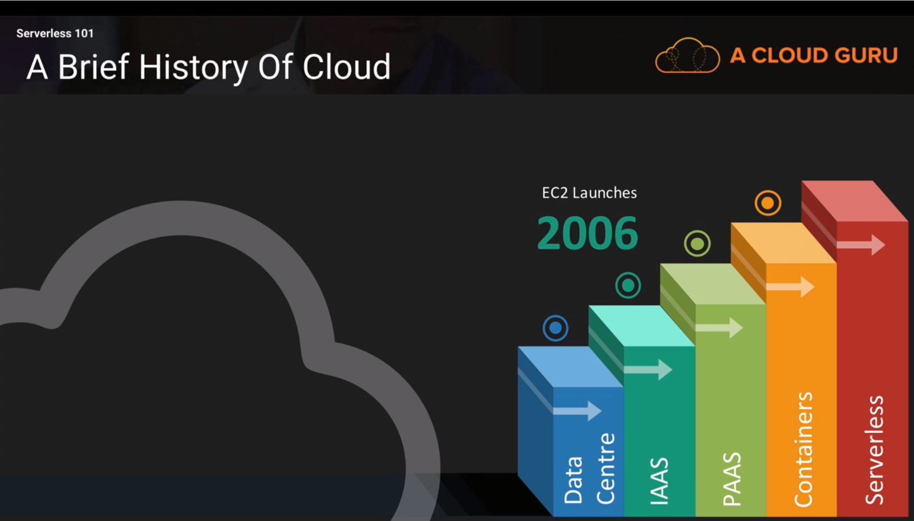
SERVERLESS —

Slide 4
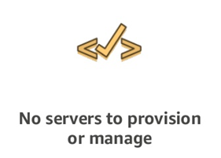
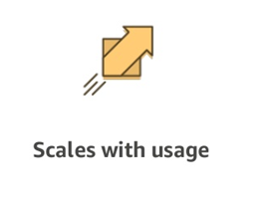
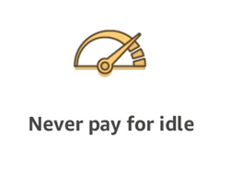
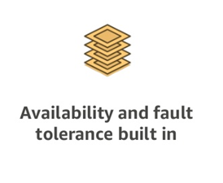
A SERVERLESS WORLD … —

Slide 5
SERVERLESS PROS
SERVERLESS CONS
No server management
Flexible Scaling
Pay for value
High availability
Time to market
“Greener” computing
Vendor control
Complexity
Configuration, deployment
Testing and Debugging

Slide 6
SERVERLESS. AWS Services —
COMPUTE AWS Lambda Lambda@Edge AWS Fargate | STORAGE S3 EFS | DATA STORES DynamoDB Aurora Serverless | ORCHESTRATION Step Functions
MESSAGING SNS SQS | API PROXY API Gateway | ANALYTICS Kinesis Athena | DEVELOPER TOOLING SAM X-Ray, Cloudwatch Codestar Codepipeline Codebuild Codedeploy Cloud9

Slide 7

AWS Fargate —

Slide 8
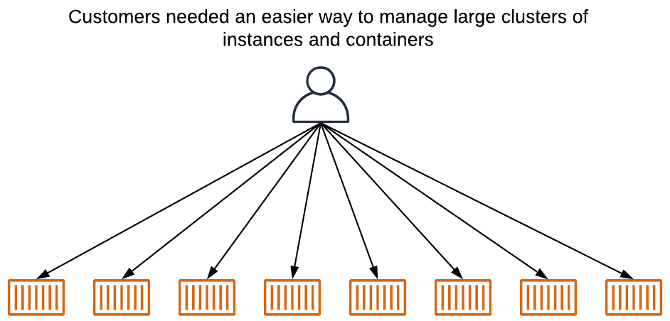
AWS Fargate. Problem —

Slide 9

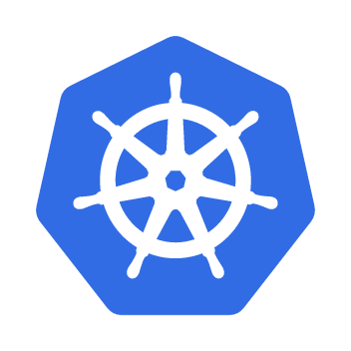
AWS Fargate. Orchestration —

Slide 10
AWS Fargate. Amazon Container Services —

Slide 11
AWS Fargate. ECS —
Amazon Elastic Container Service

Slide 12
AWS Fargate. ECS —

Slide 13
AWS Fargate. ECS —

Slide 14
AWS Fargate. Without Fargate —
Patching OS, Agents, etc.
Scaling instances fleet

Slide 15
AWS Fargate —

Slide 16
AWS Fargate. Intro —
Deploy and manage applications, not infrastructure
Right-sized resources with flexible pricing options
Secure isolation by design
Rich observability of applications

Slide 17






AWS Fargate. Use Cases —
Web Applications
Static websites
Complex web apps
Packages for Flask and Express
Backends
Apps & services
Mobile
IoT
Data Processing
Real time
MapReduce
Batch
Chatbots
Powering chatbot logic
Amazon Alexa
Powering voice-enabled apps
Alexa Skills Kit
IT Automation
Policy engines
Extending AWS services
Infrastructure management

Slide 18
AWS Fargate. Primitives —

Slide 19
AWS Fargate. Task Definition —
JSON document
List of up to 10 container definitions
All containers are co-located on the same host
Each container definition has:
A name
Image URL
And more …

Slide 20
AWS Fargate. Task CPU & Memory —
Dimensions: Task level CPU and memory
Task level resources
Execution Role
Volumes
Network mode
Compatibilities

Slide 21
AWS Fargate. Permission tiers —

Slide 22
AWS Fargate. Networking —
TASK LEVEL
Run in awsvpc networking mode – i.e each task gets its own interface
Full control via Security Groups and Network ACLs
Public IP support
SERVICE LEVEL
Recommended: Deploy services across multiple subnets for HA ( Subnets <-> Availability Zone have 1 to 1 mapping)
CLUSTER LEVEL
Recommended separate VPCs or at least CIDR ranges to prevent
Against IP exhaustion
VPC configuration changes

Slide 23
AWS Fargate. Storage —
Amazon EFS volumes for persistent storage
Ephemeral storage for nonpersistent storage – 20 GB

Slide 24
AWS Fargate. Process and architecture —

Slide 25
AWS Fargate. Monitoring —
CloudWatch Logs
CloudWatch Events
Service-level metrics
Metadata endpoint and Docker stats
Container Agent Introspection
Security Audit and Control

Slide 26
AWS Fargate. Pricing —
Pricing is per second with a 1-minute minimum.
Duration from start of download your container image until the Task terminates.
On Demand
per vCPU per hour | $0.04048
per GB per hour | $0.004445
Spot Instances
per vCPU per hour | $0.01281731
per GB per hour | $0.00140743

Slide 27
AWS Fargate. Adjustable limits —
Service quota | Description | Quota value
Clusters per account | The maximum number of clusters per Region, per account. | 10,000
Container instances per cluster | The maximum number of container instances per cluster. | 2,000
Services per cluster | The maximum number of services per cluster. | 1,000
Tasks using the EC2 launch type per service (the desired count) | The maximum number of tasks using the EC2 launch type per service (the desired count). This limit applies to both standalone tasks and tasks launched as part of a service. | 1,000
Tasks using the Fargate launch type or the FARGATE capacity provider, per Region, per account | The maximum number of tasks using the Fargate launch type or the FARGATE capacity provider, per Region. This limit applies to both standalone tasks and tasks launched as part of a service. | 100
Fargate Spot tasks, per Region, per account | The maximum number of tasks using the FARGATE_SPOT capacity provider, per Region. | 250
Public IP addresses for tasks using the Fargate launch type | The maximum number of public IP addresses used by tasks using the Fargate launch type, per Region. | 100

Slide 28
AWS Fargate. Nonadjustable limits —
Service quota | Description | Quota value
Tasks launched (count) per run-task | The maximum number of tasks that can be launched per RunTask API action. | 10
Container instances per start-task | The maximum number of container instances specified in a StartTask API action. | 10
Revisions per task definition family | The maximum number of revisions per task definition family. Deregistering a task definition revision does not exclude it from being included in this limit. | 1,000,000
Task definition size limit | The maximum size, in KiB, of a task definition. | 32
Task definition max containers | The maximum number of containers definitions within a a task definition. | 10
Subnets specified in an awsvpcConfiguration | The maximum number of subnets specified within an awsvpcConfiguration. | 16
Security groups specified in an awsvpcConfiguration | The maximum number of security groups specified within an awsvpcConfiguration. | 5
Classic Load Balancers per service | The maximum number of Classic Load Balancers per service. | 1
Tags per resource | The maximum number of tags per resource. This applies to tasks, services, task definitions, clusters, and container instances. | 50

Slide 29
AWS SQS —

Slide 30
AWS SQS —
AWS SQS is a fast, reliable, scalable, fully managed message queuing service
Eliminate administrative overhead
Reliably deliver messages
Keep sensitive data secure
Scale elastically and cost-effectively

Slide 31
AWS SQS. Functionality —
Unlimited queues and messages
Batches
Long polling
Send and read messages simultaneously
Message locking
Queue sharing
Server-side encryption
Dead Letter Queues (DLQ)

Slide 32
AWS SQS. Distributed —

Slide 33
AWS SQS. Message lifecycle —

Slide 34
AWS SQS. Queue Types —
Standard Queues
Unlimited Throughput
At-Least-Once Delivery
Best-Effort Ordering
FIFO Queues
High Throughput up to 300 per second
Exactly-Once Processing
First-In-First-Out Delivery

Slide 35
AWS SQS. Configuration —

Slide 36
AWS SQS. Monitoring —

Slide 37
AWS SQS. Pricing —
Amazon SQS Free Tier - 1 million Amazon SQS requests for free each month.
Requests
Pricing per 1 million Requests after Free tier (Monthly)
Standard Queue | $0.40 ($0.0000004 per request)
FIFO Queue | $0.50 ($0.0000005 per request)
Data
 | Pricing
Data Transfer IN | $0.00 per GB
Data Transfer OUT
Up to 1 GB / Month | $0.00 per GB
Next 9.999 TB / Month | $0.09 per GB
37

Slide 38
AWS SQS. Limits. Queues —
Quota | Description
Delay queue | The default (minimum) delay for a queue is 0 seconds. The maximum is 15 minutes.
Listed queues | 1,000 queues per ListQueues request.
Long polling wait time | The maximum long polling wait time is 20 seconds.
Message groups | There is no quota to the number of message groups within a FIFO queue.
Messages per queue (backlog) | The number of messages that an Amazon SQS queue can store is unlimited.
Messages per queue (in flight) | For most standard queues (depending on queue traffic and message backlog), there can be a maximum of approximately 120,000 inflight messages.
 | For FIFO queues, there can be a maximum of 20,000 inflight messages
Queue name | A queue name can have up to 80 characters. Alphanumeric characters, hyphens (-), and underscores (_). Queue names are case-sensitive.
 | The name of a FIFO queue must end with the .fifo suffix. The suffix counts towards the 80-character queue name quota.
Queue tag | We don't recommend adding more than 50 tags to a queue.
 | The tag Key is required, but the tag Value is optional.
 | The tag Key and tag Value are case-sensitive.

Slide 39
AWS SQS. Limits. Messages —
Quota | Description
Message attributes | A message can contain up to 10 metadata attributes.
Message batch | A single message batch request can include a maximum of 10 messages.
Message content | A message can include only XML, JSON, and unformatted text.
Message retention | Default 4 days. The minimum is 60 seconds. The maximum is 14 days.
Message throughput | Standard queues support a nearly unlimited number of API calls per second, per API action.
 | FIFO queues If you use batching, FIFO queues support up to 3,000 transactions per second. Without batching, FIFO queues support up to 300 API calls per second.
Message timer | The default (minimum) delay for a message is 0 seconds. The maximum is 15 minutes.
Message size | The minimum message size is 1 byte (1 character). The maximum is 256 KB. To send messages larger than 256 KB, you can use SQS message that contains a reference to a message payload in Amazon S3. The maximum payload size is 2 GB.
Message visibility timeout | The default visibility timeout is 30 seconds. The minimum is 0 seconds. The maximum is 12 hours.
Policy information | The maximum quota is 8,192 bytes, 20 statements, 50 principals, or 10 conditions.

Slide 40

AWS API Gateway —

Slide 41




AWS API Gateway —
Create a unified API frontend for multiple micro-services
DDoS protection and throttling for your backend
Authenticate and authorize requests to a backend
Throttle, meter, and monetize API usage by third-party developers

Slide 42
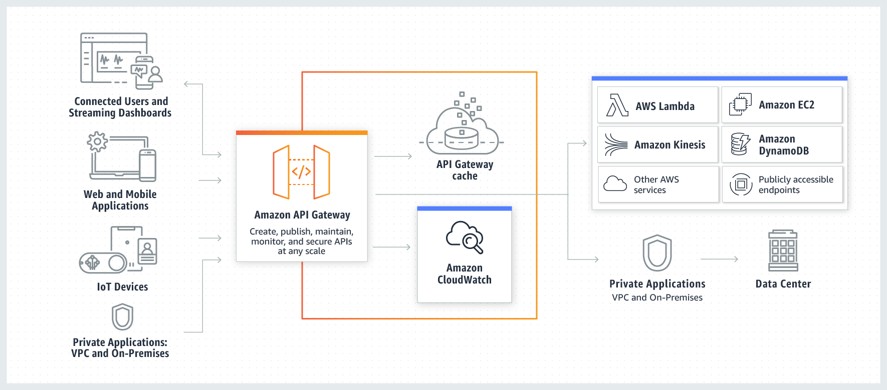
AWS API Gateway. Overview —

Slide 43
AWS API Gateway. Types —
API RESTful
API WEBSOCKET

Slide 44
AWS API Gateway. Features —
Host multiple versions and stages of your APIs
Create and distribute API Keys
Secure API
Throttle and monitor requests to protect your backend
Managed cache to store API responses
Reduced latency and DDoS protection through CloudFront
SDK Generation for iOS, Android and JS
Swagger and Open API support
Request/Response data transformation and API mocking

Slide 45
AWS API Gateway. Deployments —
API Configuration can be deployed to a stage
Stages are different environments
Dev (e.g. awsapigateway.com/dev)
Test (e.g. awsapigateway.com/test)
Stage (e.g. awsapigateway.com/stage)
Prod (e.g. awsapigateway.com/prod)

Slide 46
AWS API Gateway. Meter Usage —
Create API Keys
Combine them into Usage Plans
Set access permissions at the API/Stage level
Meter usage of API Keys through CloudWatch Logs

Slide 47
AWS API Gateway. Pricing —
FREE TIER
1M REST API CALLS RECEIVED | 1M HTTP API CALLS RECEIVED | 1M MESSAGES | 750,000 CONNECTION MINUTES
HTTP API Calls
First 300 million - $1
300+ - $0.9
REST API
First 333 million - $3.5
Over 20 billion - $1.51
Caching
58.2 GB - $1 per hour
WEBSOCKET API
First 1 billion - $1 per million
$0.25 per million connection minutes

Slide 48
AWS API Gateway. Limits —
Resource or Operation | Default Quota | Can Be Increased
Routes per API | 300 | Yes
Integrations per API | 300 | No
Maximum integration timeout | 30 seconds | No
Stages per API | 10 | Yes
Tags per stage | 50 | No
Total combined size of request line and header values | 10240 bytes | No
Payload size | 10 MB | No
Custom domains per account per Region | 120 | Yes
Access log template size | 3 KB | No
Amazon CloudWatch Logs log entry | 1 MB | No
Authorizers per API | 10 | Yes
Audiences per authorizer | 50 | No
Scopes per route | 10 | No
Timeout for JSON Web Key Set endpoint | 1500 ms | No
Timeout for OpenID Connect discovery endpoint | 1500 ms | No
VPC links per account per Region | 10 | Yes
Subnets per VPC link | 10 | Yes
Stage variables per stage | 100 | No

Slide 49

AWS Cognito —

Slide 50

AWS Cognito. Overview —
User Identity
Authentication
Authorization
User Management
Sign in users
Federation with enterprise identities
Federation with social identities
Standards-based (Oauth, SAML, OpentID)
Protect data and operations
Provide fine-grained access control
Manage user lifecycles
Store and manage user profile data
Monitor engagement

Slide 51
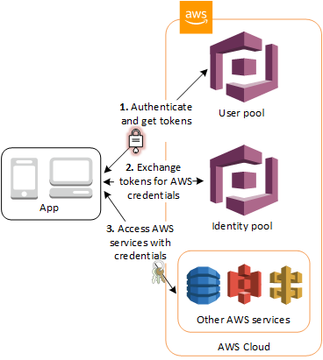
AWS Cognito. Overview —
User Pools
Domain
App Client
Resource Server
Identity Pools
Cognito Sync

Slide 52
AWS Cognito. User Pools —
Sign-up and sign-in services
A built-in, customizable web UI
Social sign-in - Facebook, Google, Amazon, SAML and OIDC.
User directory management and user profiles
Security features - MFA, checks for compromised credentials, account takeover protection, and phone and email verification
Customized workflows and user migration through AWS Lambda triggers

Slide 53
AWS Cognito. Identity Pools —
Amazon Cognito user pools
Access AWS Resources
Social sign-in with Facebook, Google, and Login with Amazon
SAML or OpenID Connect (OIDC) providers
Developer authenticated identities
IAM Roles relation
Cognito Streams
Cognito Events

Slide 54
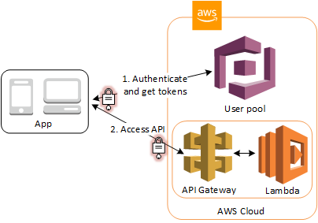
AWS Cognito. Native Support —
API Gateway Authorizers
ALB Authorizers

Slide 55
AWS Cognito. OAuth 2.0 —
OAuth flows
Authorization Code
Implicit
Client credentials
Custom scopes

Slide 56
AWS Cognito. Summary —
Serverless Security
Identity Pool is Free
User Pool
Pay per monthly active users (MAUs)
User Data Storage
Pay per sync operations
Pay per sync store

Slide 57

AWS CloudFormation —

Slide 58
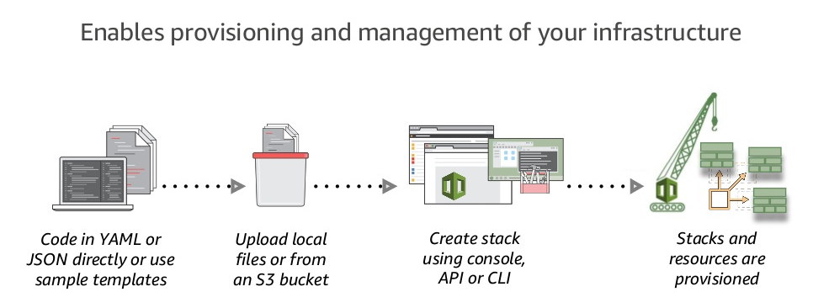
AWS CloudFormation at a Glance —

Slide 59
AWS CloudFormation. Features —
Native AWS Technology
Logical Components Relationship
Visualization
Rollbacks Support
Resources Cleanup
Preview Changes
Costs Trekking
Integration with other AWS Services
Safety Controls
Extensibility

Slide 60
AWS CloudFormation. Benefits and Tools —
Unify Deployment
Detect Changes
CDK
ClaudFormation Macroses
Infrastructure Tests/Validation Pipeline
AWS Serverless Application Repository
Different Deployment Types - Green/Blue, Canary, A/B Testing
AWS Service Catalog

Slide 61

AWS CloudFront —

Slide 62
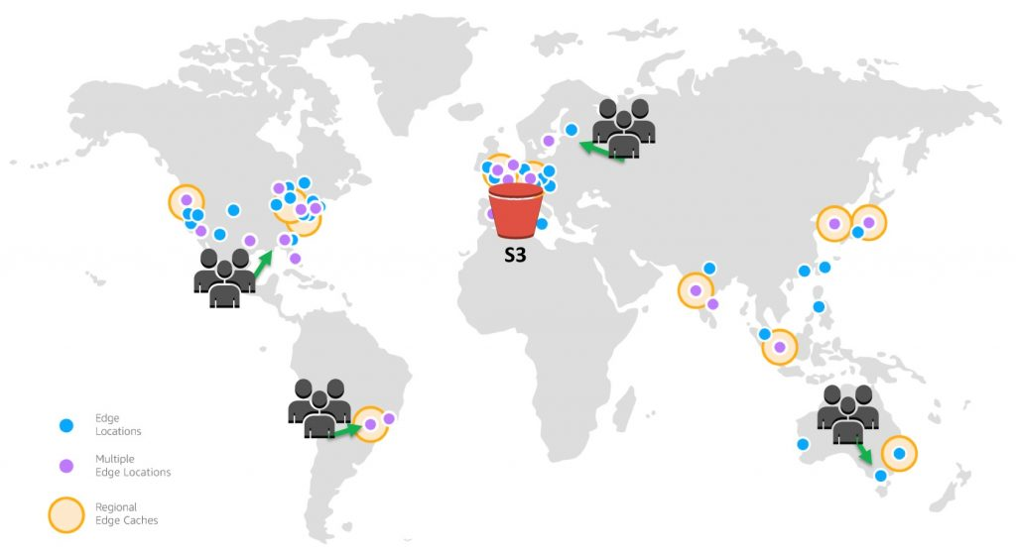
AWS CloudFront —

Slide 63
AWS CloudFront. Features —
Global Amazon Infrastructure
Security
Availability
Performance
Programmable and DevOps Friendly
Lambda@Edge
Cost Effective

Slide 64

AWS CloudWatch —

Slide 65
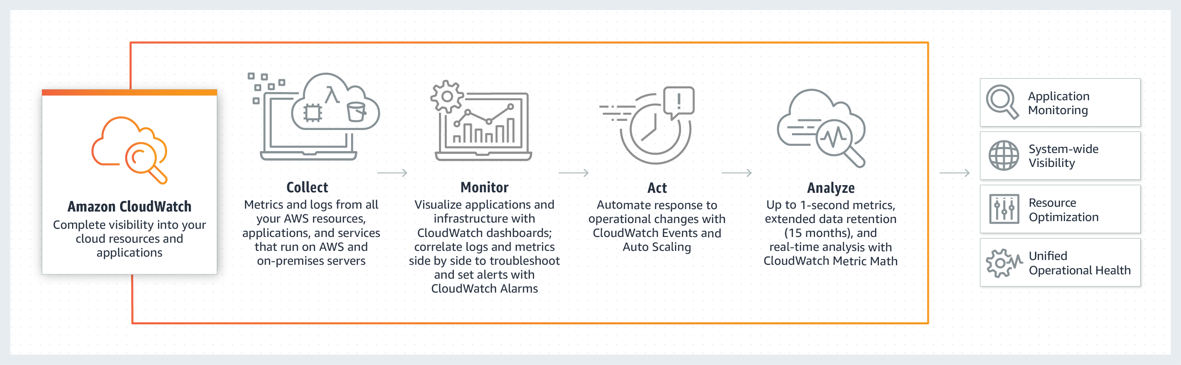
AWS CloudWatch. Overview —

Slide 66
AWS CloudWatch. Features —
Collect
Store logs and Build-in or custom metrics
Monitor
Operational dashboards
High resolution alarms, anomaly detection
Application Insights for .NET and SQL Servers apps
Act
Auto Scaling and CloudWatch Events
Analyze
Compliance and Security

Slide 67
APPLICATION OVERVIEW —
DEMO

Slide 68
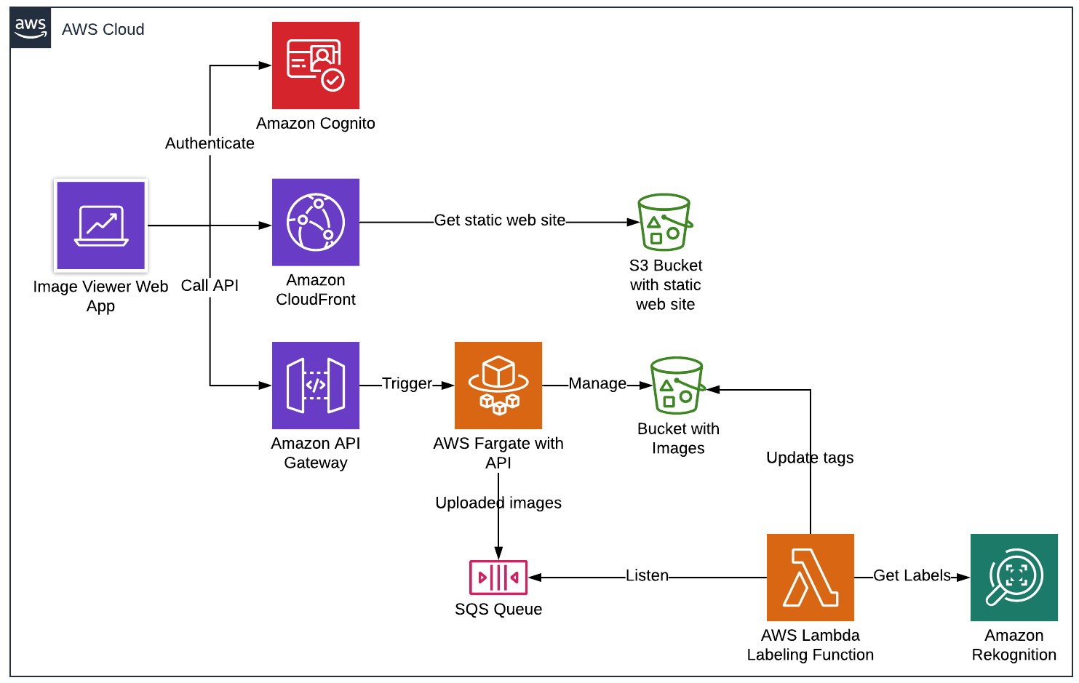
APPLICATION OVERVIEW —

Slide 69
PRACTICE —
https://github.com/illiasaveliev/image-viewer-containers

Slide 70
THANK YOU!

